Slide 1
Tolcap Example
Analysing a Design with Tolcap
How, When and Why

Slide 2
Tolcap Example - Objectives
This simplified example sets out to show
How to analyse a design using Tolcap.
How to calculate a stack tolerance.
The example also shows
When to use Tolcap: As early in the design stage as possible.
How Tolcap raises questions about the design: Questions you need to address with your supplier - to ensure you have a sound design.

Slide 3
Tolcap Example – a ‘Camera’
A ‘camera’ has three components
a heat sink
body
and lens.
The table also shows the dimensions and first cut tolerances in the ‘stack’ that defines the image distance in the camera.
Component | Process | Material | Dim | Capable ±Tol at Cpk=1.33
Heatsink | Die casting | Brass | 3 | 0.05
Body | Turning & Boring | Brass (die casting) | 12 | 0.010
Lens | Injection Moulding | PMMA | 7 | 0.10

Slide 4
Camera Tolerance Stack
Accepting the assigned tolerances, the distance from the front of the lens to the ‘image’ on the heat sink is 22 ± 0.16.
We may ‘Root-Sum-Square’ the tolerances and say the stack dimension is 22 ± 0.11225 (OK - 22 ± 0.11).
But is ‘Root-Sum-Squaring’ valid and meaningful?
Anyway, are the component tolerances achievable? Let’s use Tolcap to estimate C_{pk} for the assigned tolerances.

Slide 5
Camera Heat Sink Analysis
Open Tolcap and log in: https://tce.Tolcap.com/login

Slide 6
Camera Heat Sink Analysis
To analyse the Heat Sink
Select ‘Casting’ and ‘Precision pressure die casting for copper alloys’
Enter the dimension 3 and tolerance 0.05
Click ‘CALCULATE CPK AND PPM’
There is no prompt to select the material, because this map is specific to the material.
There is no modification required in either the Geometry or Variation Wizard, but even so, C_{pk} is estimated at 0.69 – an unacceptably low answer.

Slide 7
Camera Heat Sink Analysis
To find the capable tolerance:
Click the Cpk tab
Select 1.33 as the target C_{pk}
Click ‘CALCULATE TOLERANCE AND PPM’
To achieve C_{pk} = 1.33 the minimum tolerance estimated is ± 0.08.

Slide 8
Camera Body Analysis
Next analyse the Body:
Select ‘Machining’ and ‘Turning and boring’
Enter the dimension 12 and tolerance 0.01.
Click ‘CALCULATE CPK AND PPM’
The predicted C_{pk} is 1.64, but…

Slide 9
Camera Body Analysis
Click the Material drop down arrow and select ‘Non-ferrous Copper Alloy’
The predicted C_{pk} falls to 1.4.

Slide 10
Camera Body Analysis
Next click the ‘GEOMETRY WIZARD’.
The Body starts as a casting to save material, so it has to be turned round at some point in the machining process.
So specify ‘1 additional set-up operation’
Click ‘APPLY’.

Slide 11
Camera Body Analysis
The predicted C_{pk} is 1.29 which is close enough to 1.33 to be considered an acceptable design.

Slide 12
Camera Lens Analysis
For the Lens
Select ‘Plastic Moulding’ and ‘Injection compression PETP (filled), PF, PMMA…’
Enter the dimension 7 and tolerance 0.1
Click ‘CALCULATE CPK AND PPM’
C_{pk} is 2.34 so far…

Slide 13
Camera Lens Analysis
Next click the ‘GEOMETRY WIZARD’
The characteristic is across the parting line (which it wasn’t on the heatsink).
Select ‘ Yes – The characteristic is across the die/mould parting line‘
and click ‘APPLY’
The predicted C_{pk} falls to 1.22...

Slide 14
Camera Lens Analysis
Next click the ‘VARIATION WIZARD’
Does the need for optical properties impose any limitations on material flow etc.?
Don’t know? Then …
Select ‘Yes’ in answer to the last question.
Click ‘Apply’
The predicted C_{pk} is 0.66…

Slide 15
Camera Lens Analysis
To find a tolerance that gives an acceptable C_{pk}
Select the ‘Cpk’ tab
Set target C_{pk} to 1.33
Click ‘CALCULATE TOLERANCE AND PPM’
- to find the tolerance should be at least ±0.16

Slide 16
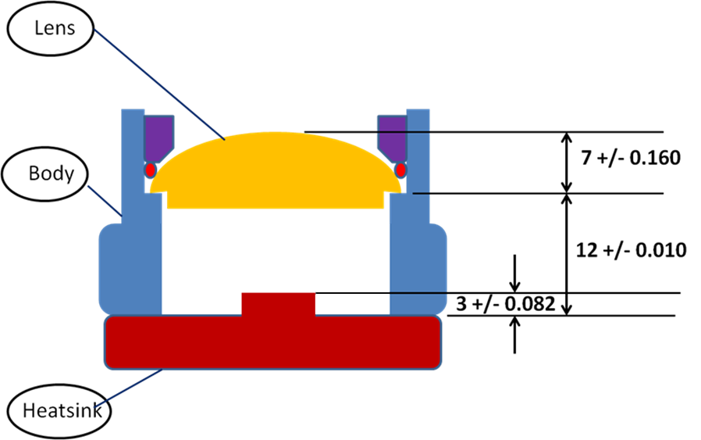
Camera Design – Capable Tolerances!
Component | Process | Material | Dimension | Capable ±Tol at Cpk=1.33
Heatsink | Die casting | Brass | 3 | 0.082
Body | Turning & Boring | Brass (die casting) | 12 | 0.010
Lens | Injection Moulding | PMMA | 7 | 0.160

Slide 17
Camera Capable Tolerance Stack
Now with capable tolerances, the distance from the front of the lens to the ‘image’ on the heat sink is 22±0.25 (0.252) .
The ‘Root-Sum-Square’ the tolerances is 0.180.
Using the formula derived for Cpk = 1.33 tolerances:
t_{stack} = Σ (t_{i}) x 3/11 + √Σ(t_{i})² x 8/11 (see our ‘Tolcap Stacks’ presentation)
we get t_{stack} = 0.199685 (OK - 0.200)

Slide 18
Camera Example: Discussion
This design is presented to illustrate how to use Tolcap and how to calculate a stack tolerance. That said, it also serves to highlight when to use Tolcap and how it can improve the design process.
The example is presented as a diagram
Tolcap is best used early in the design process
Before a drawing commits you to some concept.
Don’t just look at the C_{pk} values or tolerances you get from Tolcap - look at
the processes you selected
and the answers you gave in the wizards
these can steer your design and your project.

Slide 19
Lens: Discussion
7 ± 0.160
Component | Map | Material | Geometry Effect | Additional Variation | Capable Tolerance
Lens | 0.063 | PMMA - used Injection compression PETP (filled), PF, PMMA… | 1.7 | 1.5 | 0.16
Does the requirements for optical properties affect process capability?
Ask the supplier for evidence that it does not.

Slide 20
Lens: Discussion 2
7 ± 0.160
Component | Map | Material | Geometry Effect | Additional Variation | Capable Tolerance
Lens | 0.063 | PMMA | 1.7 | 1.5 | 0.16
Is dimensioning to the front of the lens avoidable. Is it even appropriate?
If so, consider mounting the lens inside the body onto the front face, so that the dimension is in one side of the die.
But look at the optical equations: the thickness of the lens will have an effect on its focal length, but maybe the shape should be adjusted and the optical centre brought in line with the mounting feature?
Review the optics and sensitivity to dimensional errors

Slide 21
Heat Sink: Discussion
3 ± 0.082
Component | Map | Material | Geometry Effect | Additional Variation | Capable Tolerance
Heatsink | 0.082 | Brass - used Precision pressure die casting for copper alloys |  |  | 0.82
The design assumes that a raw casting will be satisfactory
It may be necessary to machine the casting
To ‘clean up’ the faces
Or to achieve higher tolerances if it is necessary to improve the stack tolerance

Slide 22
Heat Sink: Discussion
12 ± 0.010
Component | Map | Material | Geometry Effect | Additional Variation | Capable Tolerance
Body | 0.008 | Brass (die casting) – used Non-ferrous Copper Alloy | 1.1 |  | 0.01
The capable tolerance is an order of magnitude smaller than for the other components in the stack. This may be an opportunity for cost reduction.
Do we need to machine the casting?
Is there an alternative process to produce the part?

Slide 23
Tolcap Example Objectives
We hope this example has demonstrated
How to analyse a design using Tolcap.
How to calculate a stack tolerance.
When to use Tolcap i.e. as early in the design stage as possible
How Tolcap raises questions about the design
Questions you need to address with your supplier - to ensure you have a sound design.
Questions to pose about your design - and tasks to incorporate into the design project.

Slide 24
For more information visit
www.tolcap.com

